Slide 1
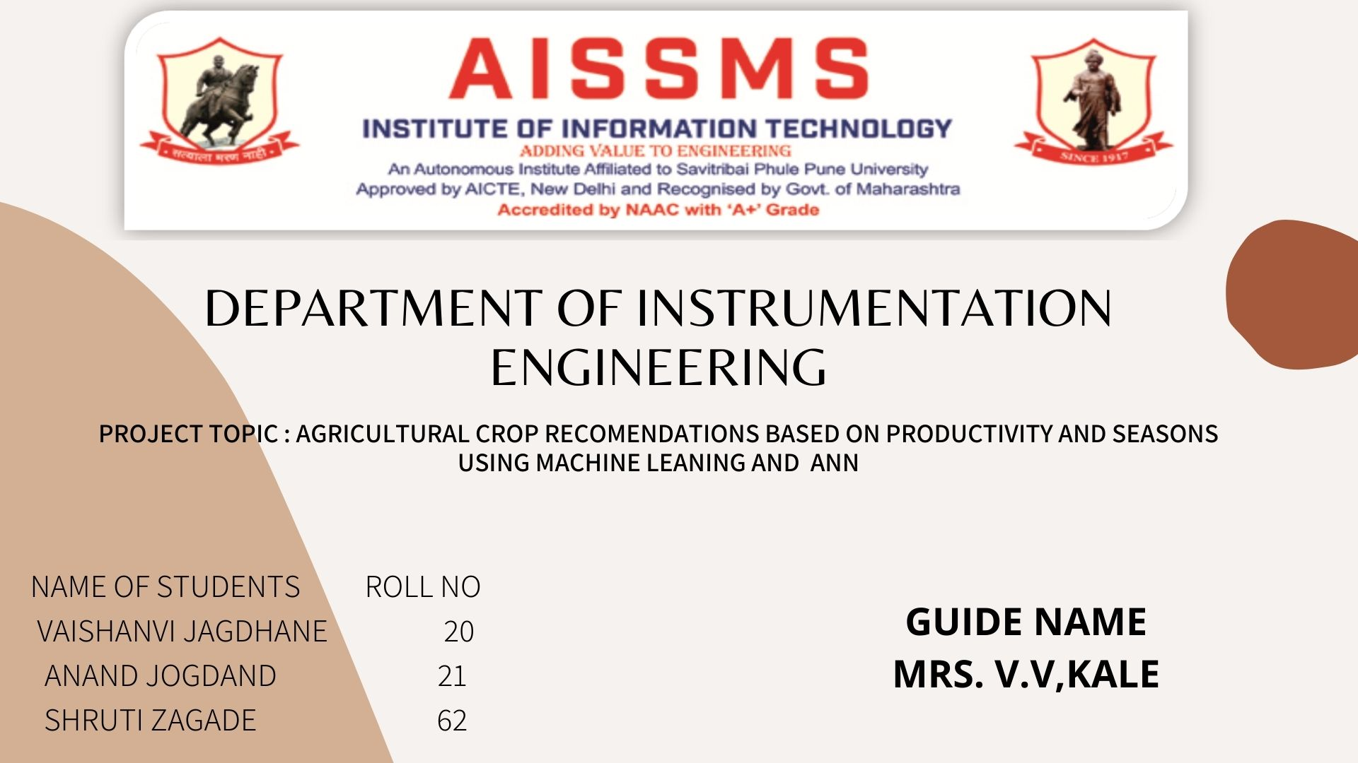
Internet plus＋project plan
Mao
Design
PROJECT TOPIC-crop recommendation system using machine learning
Dr.V.V.KALE

Slide 2
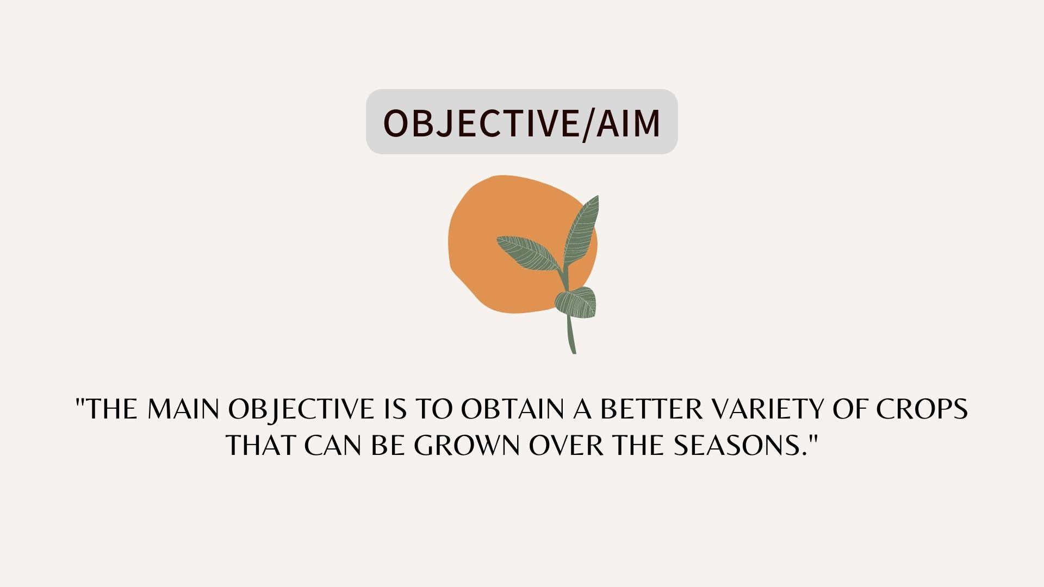

Slide 3
Paper | Author | Methodology | Drawback | Overcome
A Study on Various Data Mining Techniques for Crop Yield Prediction | Yogesh Gandge, Sandhya | Most of the research papers that were studied have considered some climatic parameters like temperature, humidity, rainfall. Some agronomical parameters like soil, nutrient contents like N, P, K, and pesticides etc.The values of these variables have been taken as input. | Improper Implementation Can Cause Much More Harm Than Good. | data analytics in crop prediction, there are different techniques or and technologies to overcome the situation faced by us
Paper | Author | Methodology | Drawback | Overcome
Supporting Privacy Protection in Personalized Web Search | Lidan Shou, He Bai, Ke Chen, and Gang Chen | We also provide an online prediction mechanism for deciding whether personalizing a query is beneficial. | This practice leads to unwanted biases, errors and excessive medical costs which affects the quality of service provided to patients. | System is working for 4 different disease and is not depend on any third-party classifiers so providing very less error rates.
3

Slide 4
Paper | Author | Methodology | Drawback | Overcome
Crop prediction using predictive Analytics | P. S. Vijayabaskar, Sreemathi.R, Keertanaa.E | Predictive model establish a relationship between one or more known attributes of a unit. The main objective of this model is to obtain the similarity in different sample will exhibit the specific performance. | Obligatory Crop Diversification. Requires More Knowledge and Skills. | Crop prediction depends on the soil, geographic and climatic ... overcomes high variance by using n learners of the same size on the same.

Slide 5
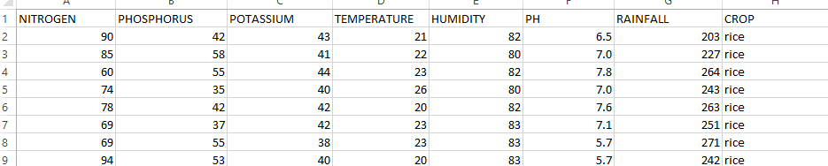
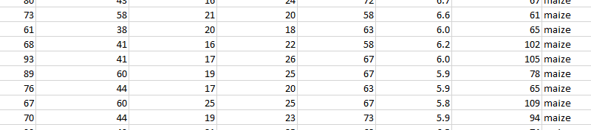
Dataset
Soil health card - For report

Slide 6
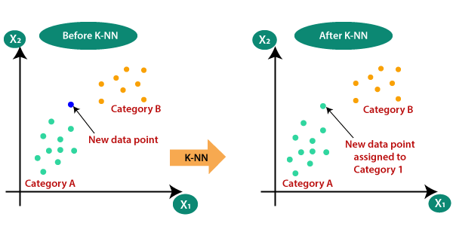
ALGORITHM USED
Why do we using a K-NN Algorithm?

Slide 7
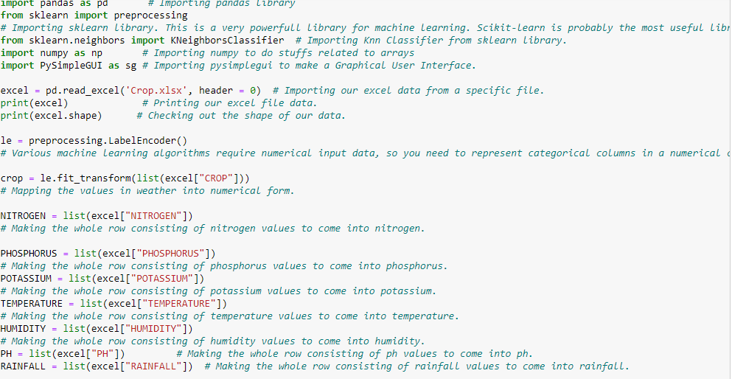
CODE

Slide 8
REFERENCE
01.Rakesh Kumar , M.P. Singh, Prabhat Kumar and J.P. Singh, “Crop Selection Method to Maximize Crop Yield Rate using Machine Learning Technique”, International Conference on Smart Technologies and Management for Computing, Communication, Controls, Energy and Material
02] T.R. Lekhaa, “Efficient Crop Yield and Pesticide Prediction for mproving Agricultural Economy using DatMining Techniques”, nternational Journal of Modern Trends in Engineering and Science
(IJMTES),
03]Jay Gholap, Anurag Ingole, Jayesh Gohil, Shailesh Gargade and Vahida Attar, “SoilData Analysis Using Classification Techniques and Soil Attribute Prediction”, International Journal of Computer Science Issues, Volume 9, Issue 3
[4] Ramanujam, R.Harine Rajashreeń, C.Kavyań, T.Kiruthikań, J.Nishań, S.Pudumalar(2016), ‘Crop Recommendation System for Precision Agriculture’(ICoAC) .
[5] Paul Monali K. Vishwakarma Santosh Ashok Verma(2015) "Analysis of Soil Behaviour and Prediction of Crop Yield using Data Mining Approach"
International Conference on Computational Intelligence and Communication Network.

Slide 9
THANKS

